Slide 1
CA683 Data Analytics and Data Mining Project
Manoj Kumar Palanisamy (16212065)
Rohit Thomas (16210779)
Anjana Aggarwal (16210381)
Champa Ramaiah (16211712)

Slide 2
Great Britain Road Accident Data
The dataset contains information about road accidents in Great Britain over the years 2004-2015.
It consists of has 70 features/columns and around approximately 16 lakh records.
Dataset Link:
https://data.gov.uk/dataset/road-accidents-safety-data

Slide 3
Step 1: Business Understanding
Predicting accident hotspots.
Predicting accident frequency and severity types (fatal accident trends)
Identifying the factors of the driver (age group, gender/driving/purpose of driving) which causes most accidents in Great Britain.
Factors like number of vehicles/pedestrian movement/traffic Vehicle Type/Vehicle manoeuvre contributing to road accidents?

Slide 4
Step 2: Data Understanding Visualisations are a great way of understanding the data. Trends have been analysed through visualisations.

Slide 5
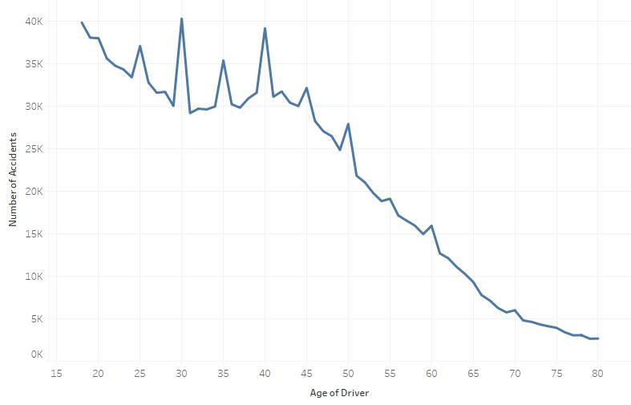
Most accidents are caused by young drivers

Slide 6
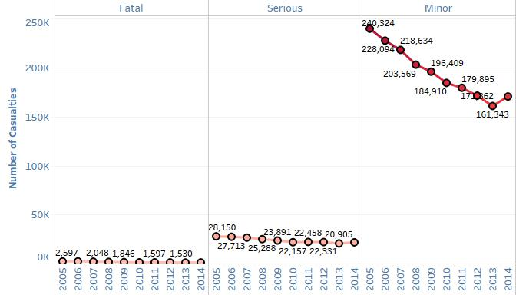
Accident Trend

Slide 7
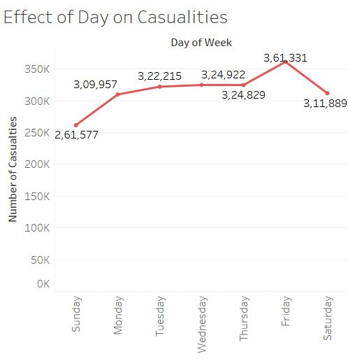

Slide 8
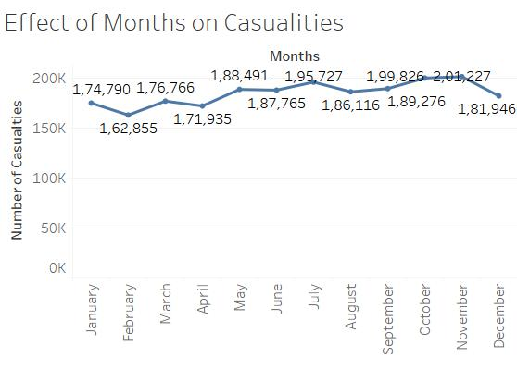

Slide 9
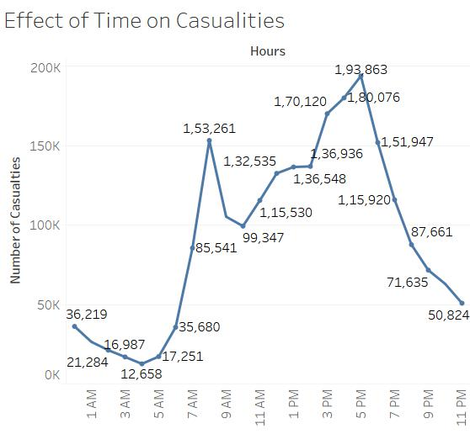

Slide 10
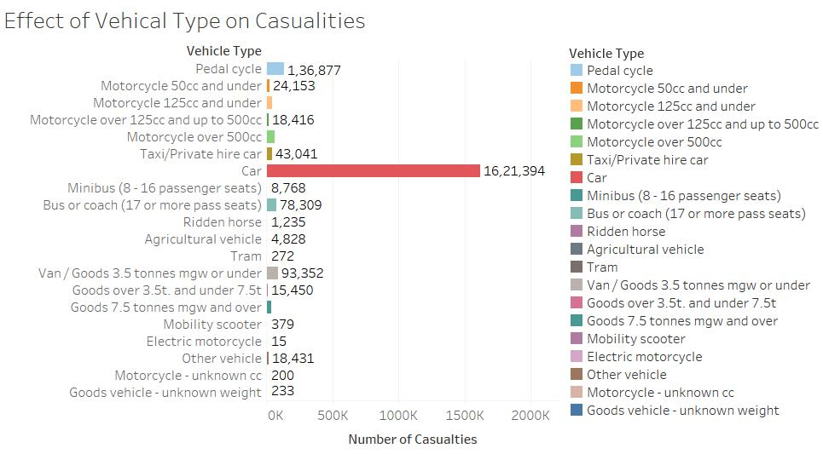

Slide 11
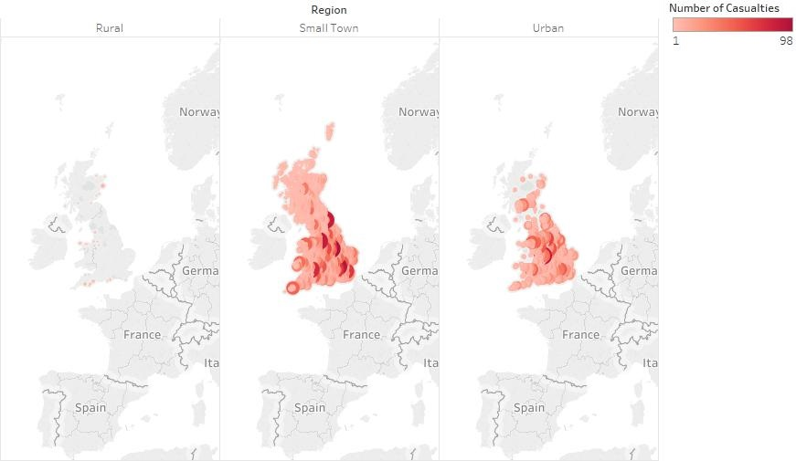
Accident Trend

Slide 12
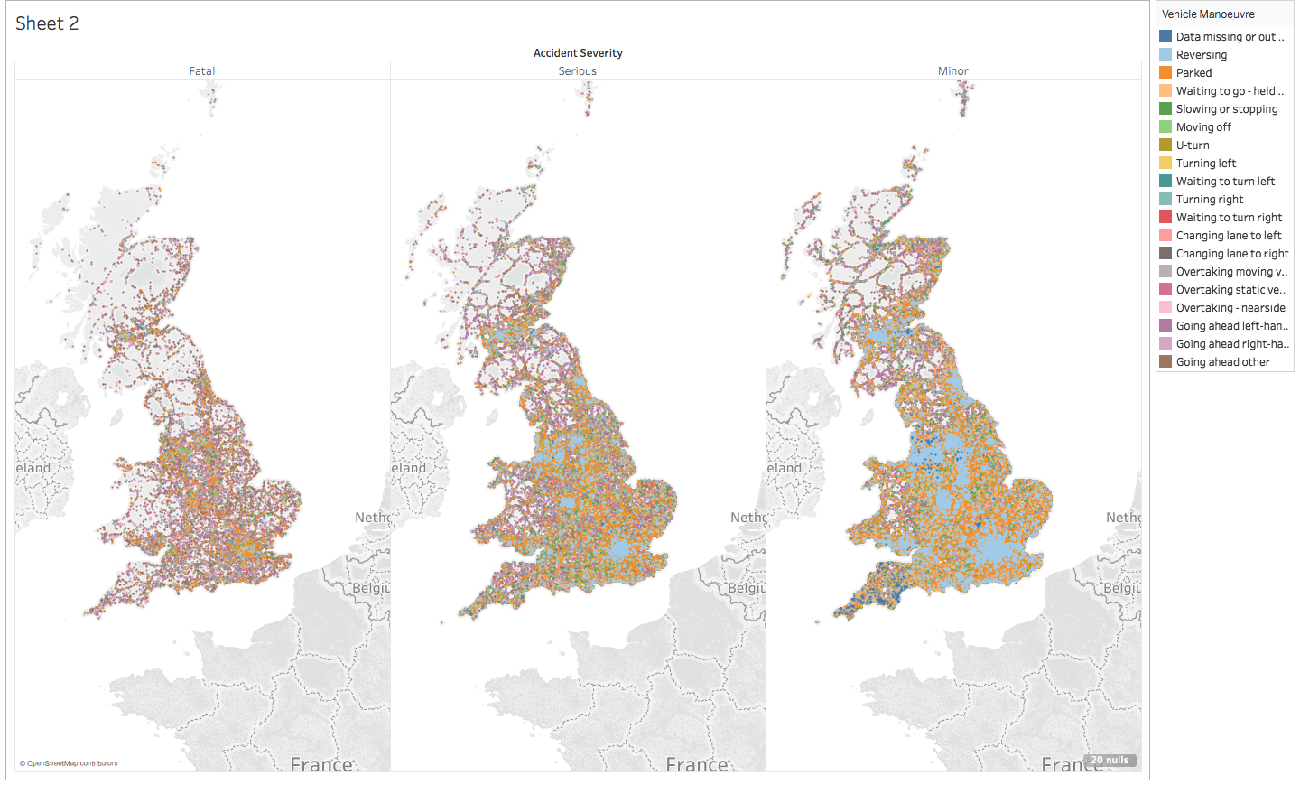
Accident Severity - Vehicle Manoeuvre

Slide 13
Step 3: Data Preparation Talend Data Integration Tool : is mainly used for data integration, data quality and data preparation Using this tool we have integrated different datasets into a single dataset.

Slide 14
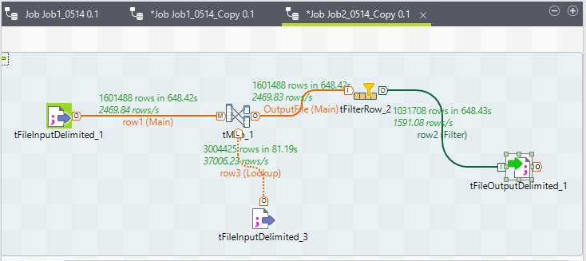

Slide 15
Step 4: Data Processing Talend – Data Integration Tool : Using Talend we have performed below data cleaning actions:
Null values are removed (~600000 rows)
Accident, Casualties and Vehicles files are integrated based on primary key accident index column
Features that are unlikely to contribute to the accident or number of casualties are removed

Slide 17
Models to be used
Predicting accident hotspots which would help in identifying areas where extra traffic control is needed : Logistic Regression
Predicting accident severity types (Fatal, serious, slight) : Decision Tree Algorithm
Predicting number of casualties : GLM

Slide 18
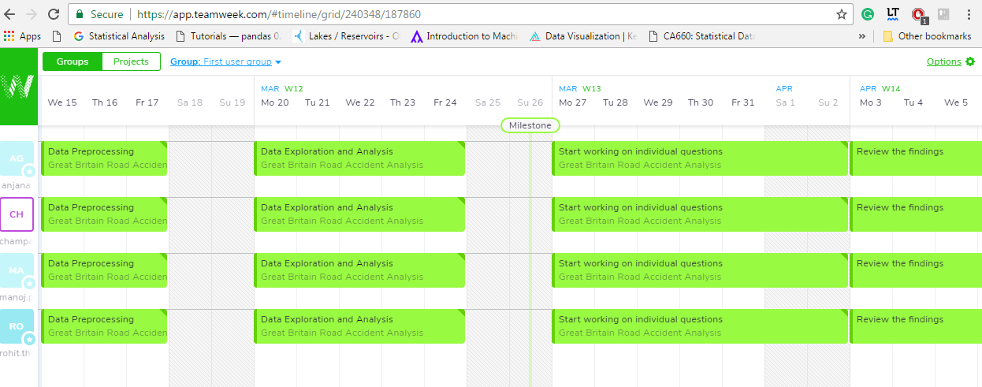
Project Plan

Slide 19
Dataset and deliverables link: https://github.com/champaramaiah/Data-Analytics-and-Mining-Project

Slide 20
Thank You

